Slide 1
How to be a Great NASPO ValuePoint Contractor
Vern Jones
NASPO ValuePoint Marketing, Education and Outreach Coordinator
Tim Hay
NASPO ValuePoint Cooperative Development Coordinator
Bart Lemmon
National SLG Contract Manager, Ricoh USA, Inc.
Steve Perlstein
Government Sales Manager, Mohawk Resources Ltd.

Slide 2
How does a contract start?
Ideas are generated by NASPO members
Surveys are distributed to all states
Projects are approved by the Management Board
Lead state model:
Lead state and multi-state/discipline sourcing team
NVP provides support
Lead state issues procurement under their own laws/process
Evaluation by lead state and sourcing team
Award recommendation sent to Management Board for approval
Q: How do I get a NVP contract?
A: Respond to and win a NVP procurement.

Slide 3
Once an Award has been made, The Lead State negotiates a MASTER AGREEMENT with awarded contractor(s)
Master agreement is the “umbrella agreement”
Administered by the Lead State’s Contract Administrator
Contains NVP Standard Terms and Conditions
All subsequent state or political subdivision agreements (Participating Addenda) fall under the master agreement
States have ability to negotiate additional terms and conditions in PA’s

Slide 4
Participating Addendum (PA)
Each Participating State (CPO/CIO) establishes who can purchase within their state
State and Political Subdivisions
State only
Political Subdivisions Only
Please check with NVP before executing a PA directly with a political subdivision

Slide 5
Contract Reviews (Yearly) with sourcing team
Contractor performance compared to competition, market, prior contract(s)
Opportunities and problems
Reconcile PA’s
General Industry Updates
Review sales
Review of marketing/sales strategy

Slide 6
Once You’re Awarded a WSCA-NASPO contract
Educate Contract Administrators and Sales Staff on the contract
Understand reporting requirements and administrative fees
All employees who interact with end users should be able to educate them on how an entity is or can be qualified to buy from WSCA-NASPO contract (PA process)

Slide 7
Develop action plans and sales strategies
What resources does your company have that can help promote the contract?
Educate internal stakeholders of unique appeal of W-N contracts to government entities – Legal, competitive, lower cost, convenient, best-in-class
Develop customer information and promotional materials:
Website, FAQs, Links to MA, PAs,
Cooperate with Lead State, NVP

Slide 8
What makes NVP Contracts Unique?
· Comprehensive & Multi Dimensional
· Complex with Layered Documentation
· Contain many moving parts
· May Operate Differently in each state

Slide 9
Balancing three different areas
NVP
Agreement
Contract Performance
Education

Slide 10
Focus on the value of cooperative purchasing
· Why does Cooperative Purchasing represent a good value
· The significance of the sourcing committee
· How does a well developed Contract benefit a customer
· Underscore comprehensiveness of the agreement

Slide 11
NVP Participation vs. Bid Issuance
· State of NV - Cost & Time of Bidding
· State of UT Auditor’s Report – Examining NVP
· For End Users - Value of State Procurement Endorsed Contracts
· NVP Contracts can be worked with to accommodate special needs

Slide 12
Contract Support & Maintenance
· Keep Current Pricing Schedules
· Accurate Website Information
· Billing Accuracy
· Regular Reviews with the Lead State

Slide 13
Steps to getting a NASPO ValuePoint Contract
Show Usage within states
Get a CPO’s &/or staffers attention
Persistence and follow-up
Continue talking with decision makers
CPO, staffers & using agencies within each state
Ask using agencies for a letter requesting to participate
Let CPO and staffers know your company’s economic impact within their state
I.e. what your company buys from businesses in state of __, how many employees, tax base etc.

Slide 14
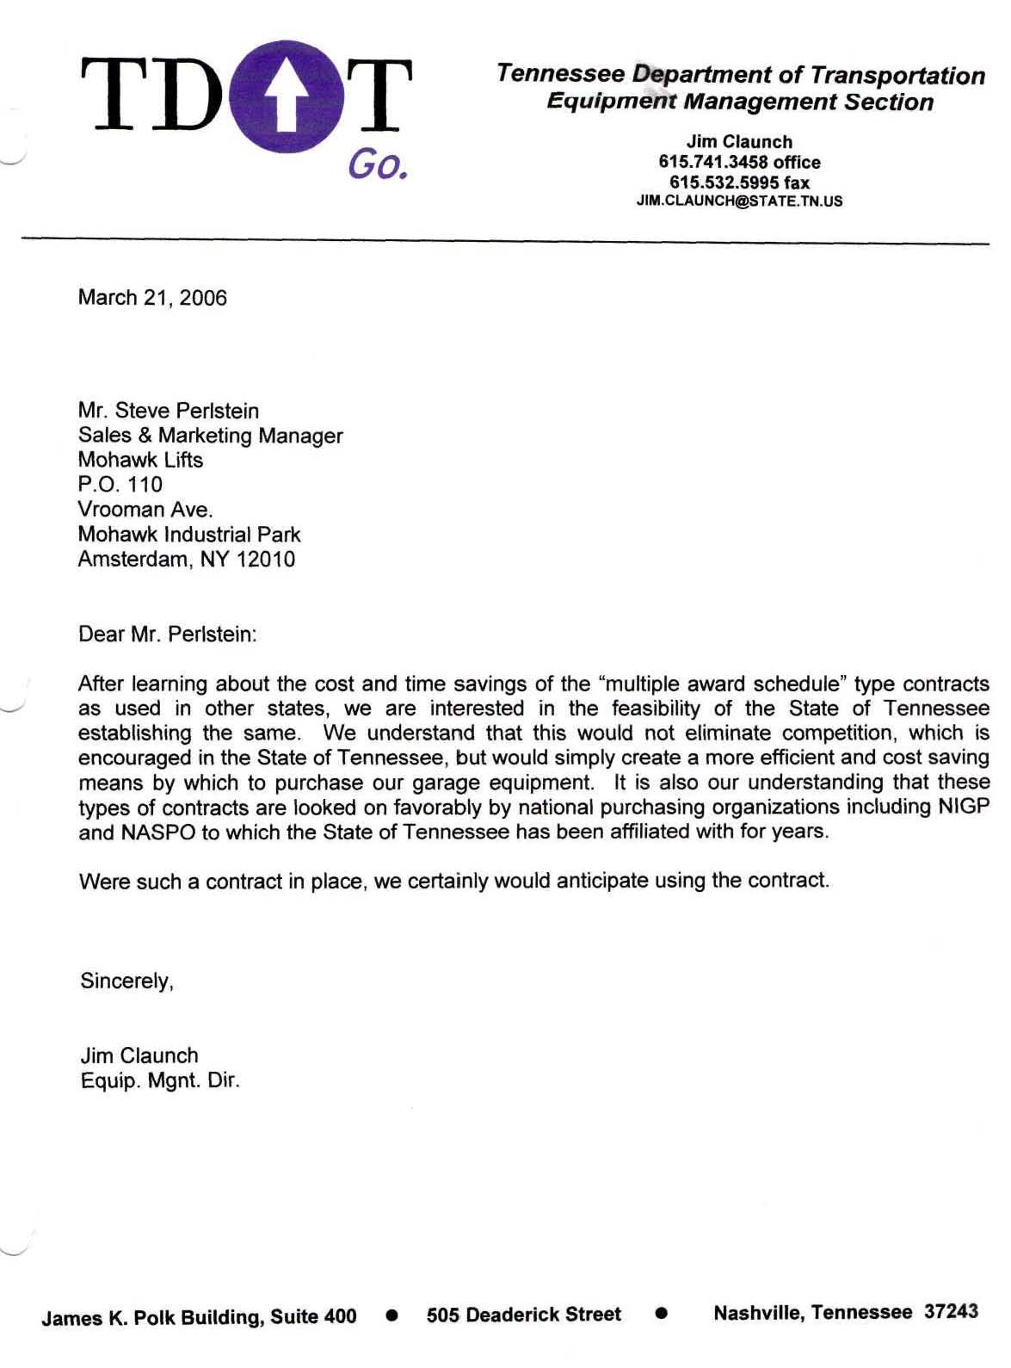

Slide 15
Once a bid is released…
Attend ALL pre-bid meetings
Ask lots of questions of procurement officer
KNOW the contract you are entering
KNOW the rules, terms and conditions of this contract
BID: Don’t become a person “looking in” on competitors who have earned an award

Slide 16
Current Contract Information
Contract No. 06405
Page 10
Highlights of the RFP Process:
• All 17 members of the Automotive Lift Institute were contacted (www.autolift.org) and all were sent bid notification.
• There were a number of meetings and conversations with potential manufacturers and suppliers regarding this
commodity.
• A pre-bid meeting was held. Five (5) different lift manufacturers were represented.
• Received Proposals from 7 of 17 members of the Automotive Lift Institute.
• Five (5) of the seven (7) proposals received went on to Step 2, Oral Interviews.
• Each offeror had to stipulate that the “MPL” prices being offered were the lowest offered to any government customer.
• All offers had to then pass the technical review committee which was made up of five (5) members of the Pacific
Northwest Fleet Managers Association. This process was a Q & A between each potential lift vendor and the five (5)
member panel.
• The review committee did not accept the offers of two (2) of the potential vendors.
• An award was made to (three) 3 vendors who collectively represent 4 (four) manufacturers of vehicle lifts, which the
State feels can adequately serve the needs of the government agencies of Washington and other WSCA and non-
WSCA states.

Slide 17
What to do once you are an awarded NASPO ValuePoint bidder
Market to state CPO’s, staffers & potential using agencies
Market to state agencies & poli subs (political subdivisions) alerting them of this new contract & simplicity of purchasing

Slide 18
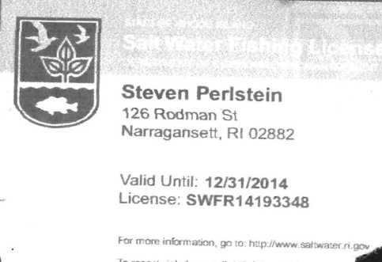
Once you have a contract (fishing license), will you let it sit there (on the couch), or will you utilize and market it (go fishing)?
VS.

Slide 19
Understand the PA “process”
Make sure your sales force understands the contract
T’s & C’s (terms and conditions) i.e. freight, volume pricing, lead time etc.
If state does not sign PA, know that transit or other gov. agencies can still use contract

Slide 21
TERMS AND CONDITIONS (sample): Information for Ordering Activities
F.O.B. delivered to 48 contiguous states.
Time of Delivery
Ordering Address: Mohawk Resources, Ltd. PO Box 110 Amsterdam, NY 12010
Payment Address: Mohawk Resources, Ltd. PO Box 110 Amsterdam, NY 12010
Installation available at open-market pricing.
(Model Dependent)
Click here to display the Intergovernmental
Purchasing Statutes (PDF)
Click here for
Retail price
sheet

Slide 22
Market contract via company website

Slide 23
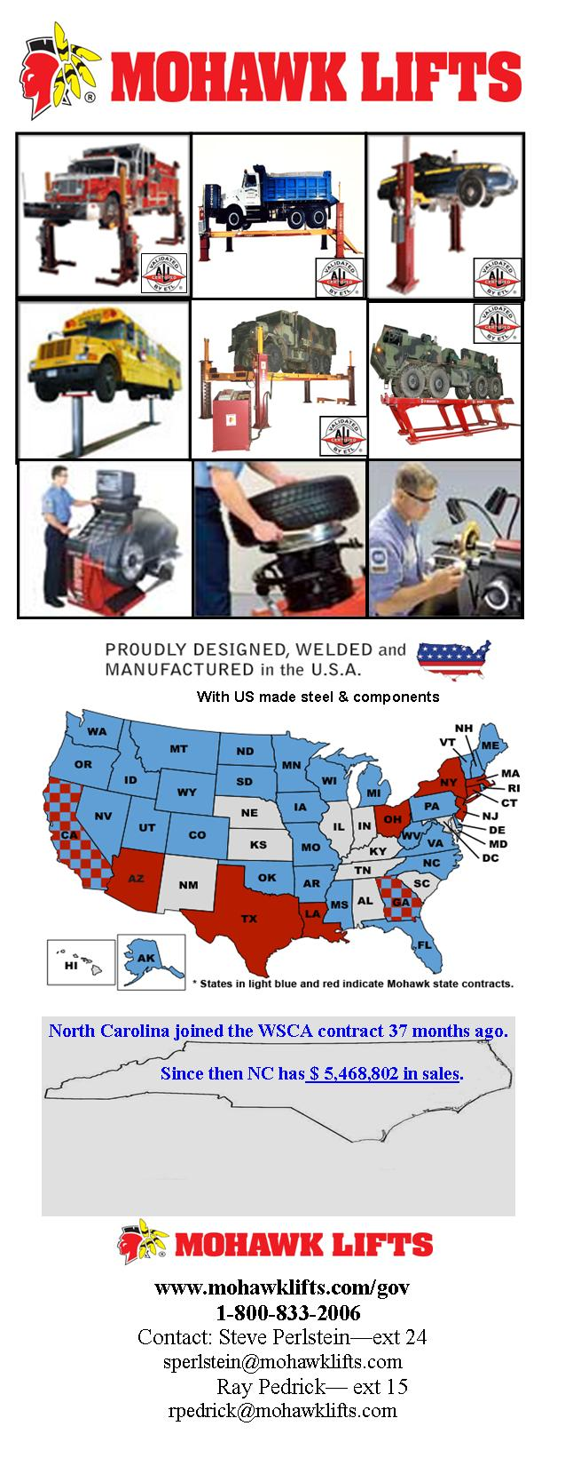
Market contract via customized handouts
MOHAWK Highlights:
Mohawk Lifts are 100% designed, engineered, welded, and assembled in the US, since 1981.
Mohawk is the #1 supplier to federal, state and local government agencies.
Mohawk Lifts are ALI/ETL Certified Lifts to meet the one and only national safety standard for vehicle lifts.
Mohawk Lifts competitively bid against 17 members of the Automotive Lift Institute and 4 lift manufacturers were chosen to serve the WSCA contract requirements.
The State of Washington is the lead state for the WSCA Vehicle Lifts contract, awarded in April 2006.
The WSCA contract T & C’s mandate the lowest government pricing.
The WSCA contract is a convenience use contract.
Mohawk’s 2-Post Lifts offer the industries only 25 year warranty (lowest cost of ownership) as no Mohawk lift has ever “worn out”

Slide 24
Market contract via quote template
-Make agencies more comfortable with contract use

Slide 25
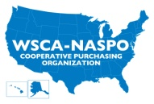
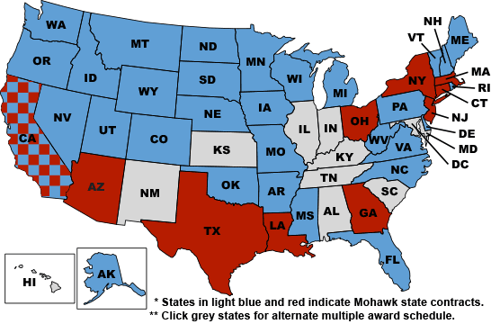
Market contract via customized business cards
Business Card Side 1
Business Card Side 2 w/ contract info
www.mohawklifts.com/gov

Slide 26
Show statement of facts (letters) from participating agencies
Facts about the WSCA Vehicle Lifts Contract:
~Contract continues to see significant growth in sales, increasing by 25% from 2007 to 2008 and 43% from 2008 to 2009.
~State participation rate is exceeding expectations. 6 states signed participating addenda in 2008, 4 states signed participating addenda in 2009, and 4 states signed in 2010
~The Vehicle Lift contract remains one of the fastest growing WSCA contracts (by participants & by contract usage increase).
~When this contract was first awarded in April 2006, estimated annual usage was approximately $250,000
• Since 2008 Q1 annual usage is approximately $6.7 million (2,689% of original estimate)
•Since 2006, total sales for all three vendors equals $42,068,344
•Since 2011, sales have been reported to 33 different states
(13 WSCA states, 20 non-WSCA states)
By far, this contract has exceeded any expectations we originally had. Thank you for your persistence and continued efforts to make this contract a success.
Richard Carlson Richard Carlson, Contracts Consultant Office of State Procurement (360) 902-7427 Office (360) 586-2426 Fax

